Slide 1
Lecture – 28
JAVA GUI (Swing)

Slide 2
Introduction
JAVA provides a rich set of libraries to create Graphical User Interface (GUI)
Swing API is set of extensible GUI components to ease developer’s life to create JAVA based Front End/GUI Applications
JAVA Libraries
  Abstract Window Toolkit (AWT) [java.awt.*]
  Swing [javax.swing.*]
  JAVAFx

Slide 3
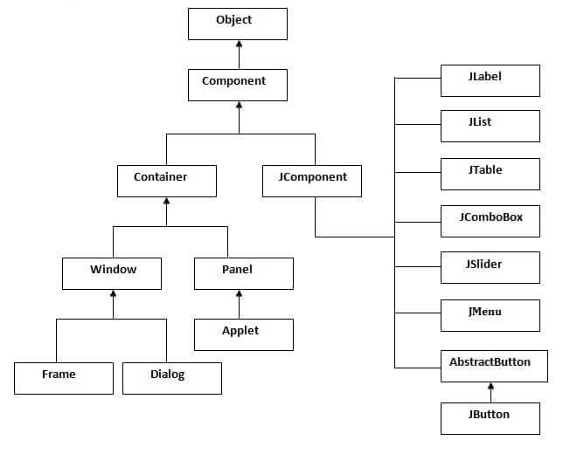
Hierarchy of Java Swing classes

Slide 4
Commonly used Methods of Component class
Method | Description
public void add(Component c) | add a component on another component.
public void setSize(int width,int height) | sets size of the component.
public void setLayout(LayoutManager m) | sets the layout manager for the component.
public void setVisible(boolean b) | sets the visibility of the component. It is by default false.
JFrame Method setDefaultCloseOperation(JFrame.EXIT_ON_CLOSE); | Returns the operation that occurs when the user initiates a "close" on this frame.

Slide 5
Java Swing Examples
There are two ways to create a frame:
  By creating the object of Frame class (association)
  By extending Frame class (inheritance)
We can write the code of swing inside the main(), constructor or any other method.

Slide 6
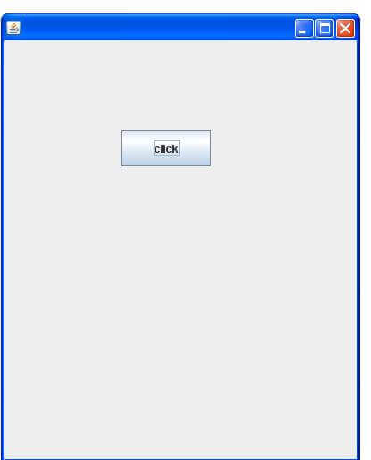
Simple Java Swing Example
import javax.swing.*;
public class FirstSwingExample {
  public static void main(String[] args) {
    JFrame f=new JFrame();//creating instance of JFrame
    JButton b=new JButton("click");//creating instance of JButton
    b.setBounds(130,100,100, 40);//x axis, y axis, width, height
    f.add(b);//adding button in JFrame
    f.setSize(400,500);//400 width and 500 height
    f.setLayout(null);//using no layout managers
    f.setVisible(true);//making the frame visible
}
}

Slide 7
Example of Swing by Association inside constructor
import javax.swing.*;
public class Simple {
  JFrame f;
  Simple(){
    f=new JFrame();//creating instance of JFrame
    JButton b=new JButton("click");//creating instance of JButton
    b.setBounds(130,100,100, 40);
    f.add(b);//adding button in JFrame
    f.setSize(400,500);//400 width and 500 height
    f.setLayout(null);//using no layout managers
    f.setVisible(true);//making the frame visible
  }
  public static void main(String[] args) {
  new Simple();
  }
}

Slide 8
Simple example of Swing by inheritance
import javax.swing.*;
public class Simple2 extends JFrame{//inheriting JFrame
  JFrame f;
  Simple2(){
    JButton b=new JButton("click");//create button
    b.setBounds(130,100,100, 40);
    add(b);//adding button on frame
    setSize(400,500);
    setLayout(null);
    setVisible(true);
  }
  public static void main(String[] args) {
  new Simple2();
  }
}

Slide 9
Java Jbutton
[javax.swing.JButton]
Constructor | Description
JButton() | It creates a button with no text and icon.
JButton(String s) | It creates a button with the specified text.
JButton(Icon i) | It creates a button with the specified icon object.
Methods | Description
void setText(String s) | It is used to set specified text on button
String getText() | It is used to return the text of the button.
void setEnabled(boolean b) | It is used to enable or disable the button.
void setIcon(Icon b) | It is used to set the specified Icon on the button.
Icon getIcon() | It is used to get the Icon of the button.
void setMnemonic(int a) | It is used to set the mnemonic on the button.
void addActionListener(ActionListener a) | It is used to add the action listener to this object.

Slide 10
Java JLabel
String getText() | t returns the text string that a label displays.
void setText(String text) | It defines the single line of text this component will display.
void setHorizontalAlignment(int alignment) | It sets the alignment of the label's contents along the X axis.
Icon getIcon() | It returns the graphic image that the label displays.
int getHorizontalAlignment() | It returns the alignment of the label's contents along the X axis.

Slide 11
Java JTextField
Methods | Description
void addActionListener(ActionListener l) | It is used to add the specified action listener to receive action events from this textfield.
Action getAction() | It returns the currently set Action for this ActionEvent source, or null if no Action is set.
void setFont(Font f) | It is used to set the current font.
void removeActionListener(ActionListener l) | It is used to remove the specified action listener so that it no longer receives action events from this textfield.

Slide 12
Event Handling
Changing the state of an object is known as an event.
  For example, click on button, dragging mouse etc.
The java.awt.event package provides many event classes and Listener interfaces for event handling.

Slide 13
Java Event classes and Listener interfaces
Event Classes | Listener Interfaces
ActionEvent | ActionListener
MouseEvent | MouseListener and MouseMotionListener
MouseWheelEvent | MouseWheelListener
KeyEvent | KeyListener
ItemEvent | ItemListener
TextEvent | TextListener
AdjustmentEvent | AdjustmentListener
WindowEvent | WindowListener
ComponentEvent | ComponentListener
ContainerEvent | ContainerListener
FocusEvent | FocusListener

Slide 14
Steps to perform Event Handling
Register the component with the Listener
  For registering the component with the Listener, many classes provide the registration methods.
  Button
    public void addActionListener(ActionListener a){}
  MenuItem
    public void addActionListener(ActionListener a){}
  TextField
    public void addActionListener(ActionListener a){}
    public void addTextListener(TextListener a){}

Slide 15
Java Event Handling Code
We can put the event handling code into one of the following places:
  Within class
  Other class
  Anonymous class

